Slide 1
Annual Utility Coordination Meeting
Spring 2022

Slide 2
Agenda
Introductions / Information Sharing
Sound Transit Lynnwood Link Extension Project Update
Surface Water Utility Reminders
City of Shoreline Projects (2022 and beyond)
Utility Providers Description of Upcoming Projects
Open Discussion / Feedback

Slide 3
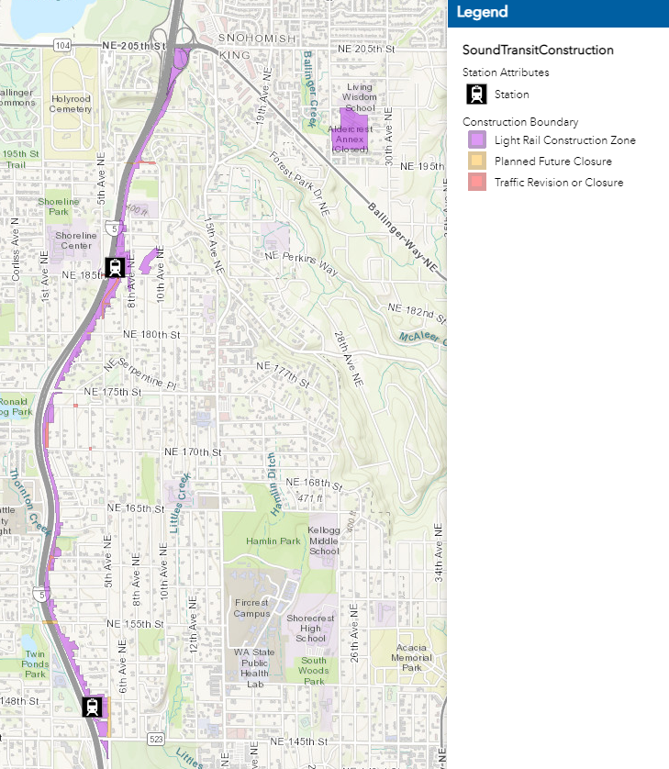
Lynnwood Link Extension
Project Limits: Periodic closures at all Interchanges 5th Ave NE @ NE 145th St to NE 148th St NE 195th St @ I-5 to 10th Ave NE NE 189th St. @ I-5 to 8th Ave NE and 8th Ave NE from NE 189th St. to NE 185th St 5th Ave NE @ NE 182nd Ct to NE 185th St 1st Ave NE @ NE 170th St to NE 174th St 1st Ave NE @ NE 159th St to NE 161st St
Scope: Utility relocation/modification Roadway reconstruction of 5th, 8th, 1st Ave NE and NE 195th and 185th St. Guideway, Stations, Garages, and Transit Loops
Status: In construction
Construction Window: 2019-2023
Ginger Ferguson, PE
ST L200 Construction Manager
(206) 398-5138
ginger.ferguson@soundtransit.org
Soundtransit.org/lynnwoodlink
Juniper Nammi, AICP
City of Shoreline Light Rail PM
(206) 801-2525
jnammi@shorelinewa.gov

Slide 4
Surface Water Utility – Dan Sinkovich
Surface Water Utility Reminders
Discharges of Potable Water to City Right-of-Way
Staging of Utility Materials in Stormwater Ditches
Utility Cross Bore Removals Continue

Slide 5
If you have questions, contact Stefan Grozev at (206) 801-2453 or sgrozev@shorelinewa.gov

Slide 8
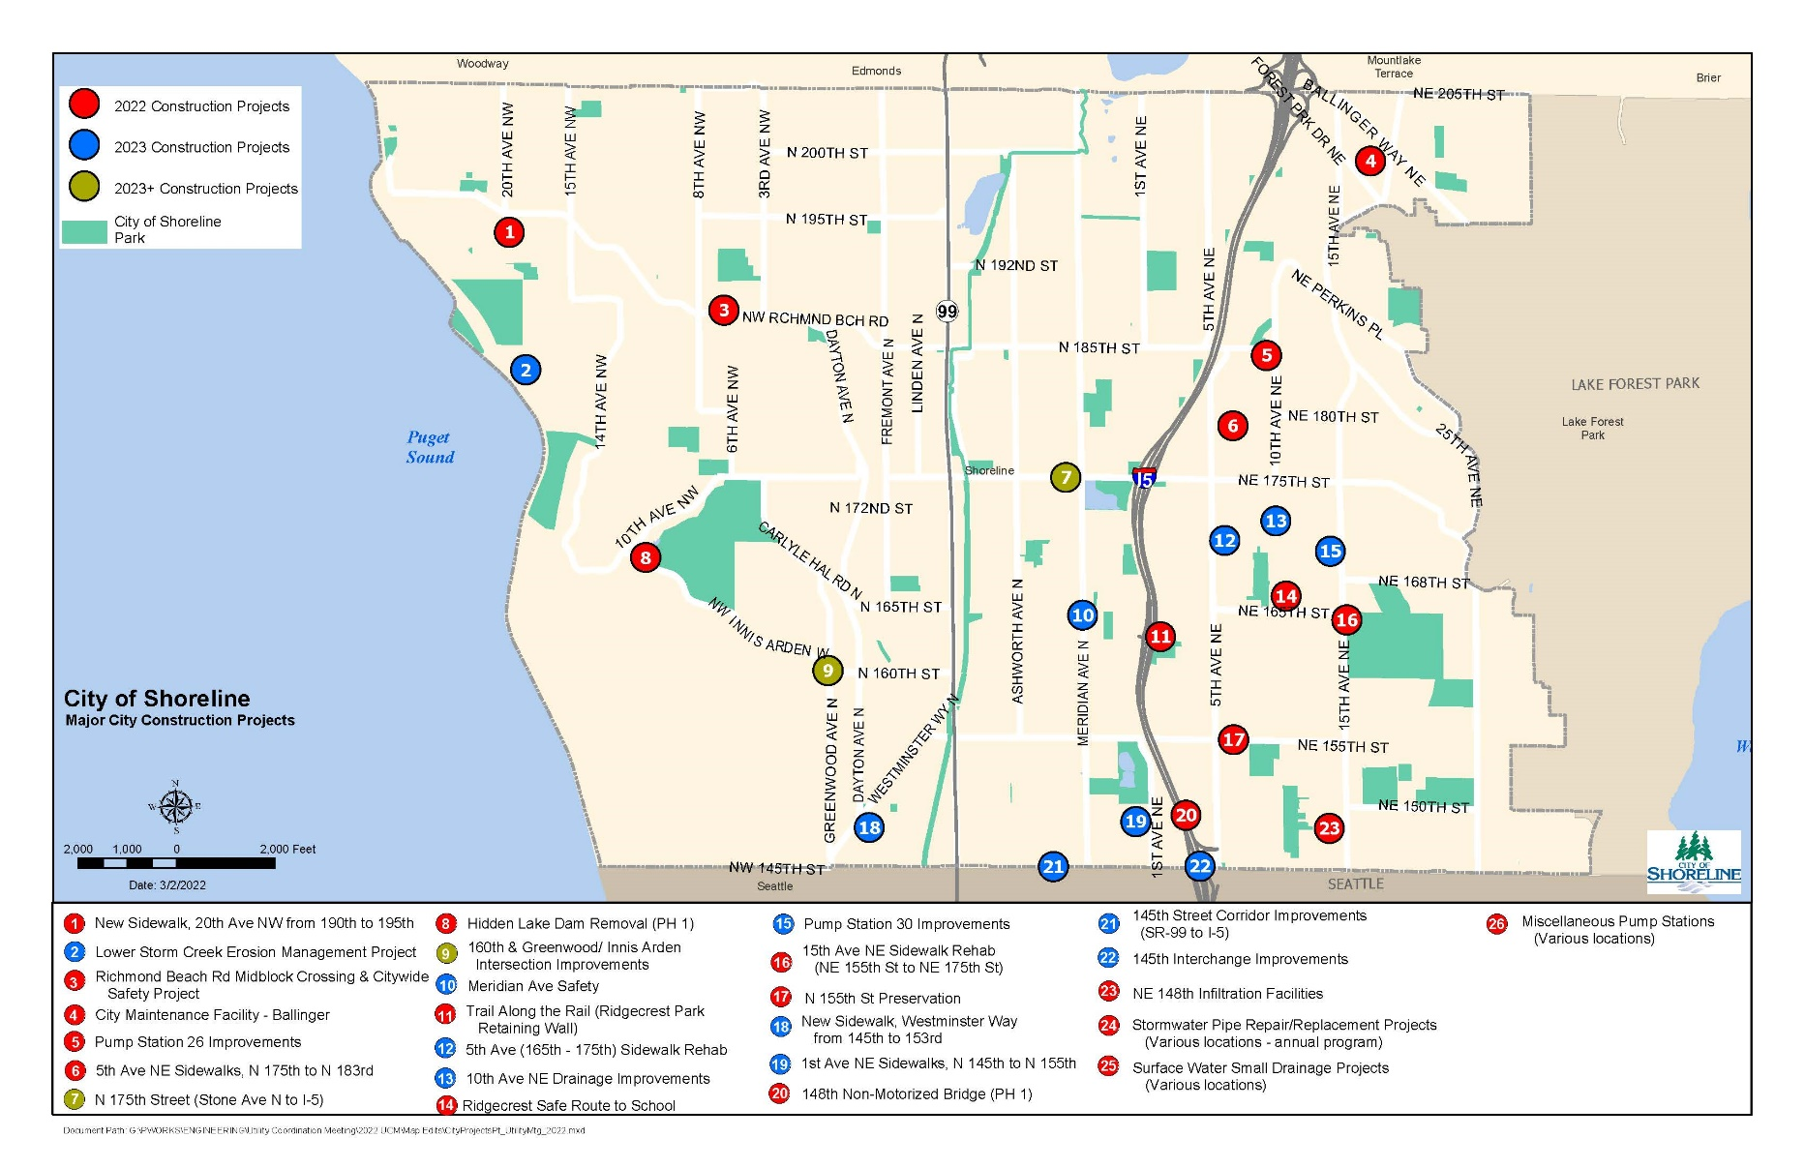
City of Shoreline 2022-2027 CIP

Slide 9
Capital Improvement Map, page 2

Slide 10
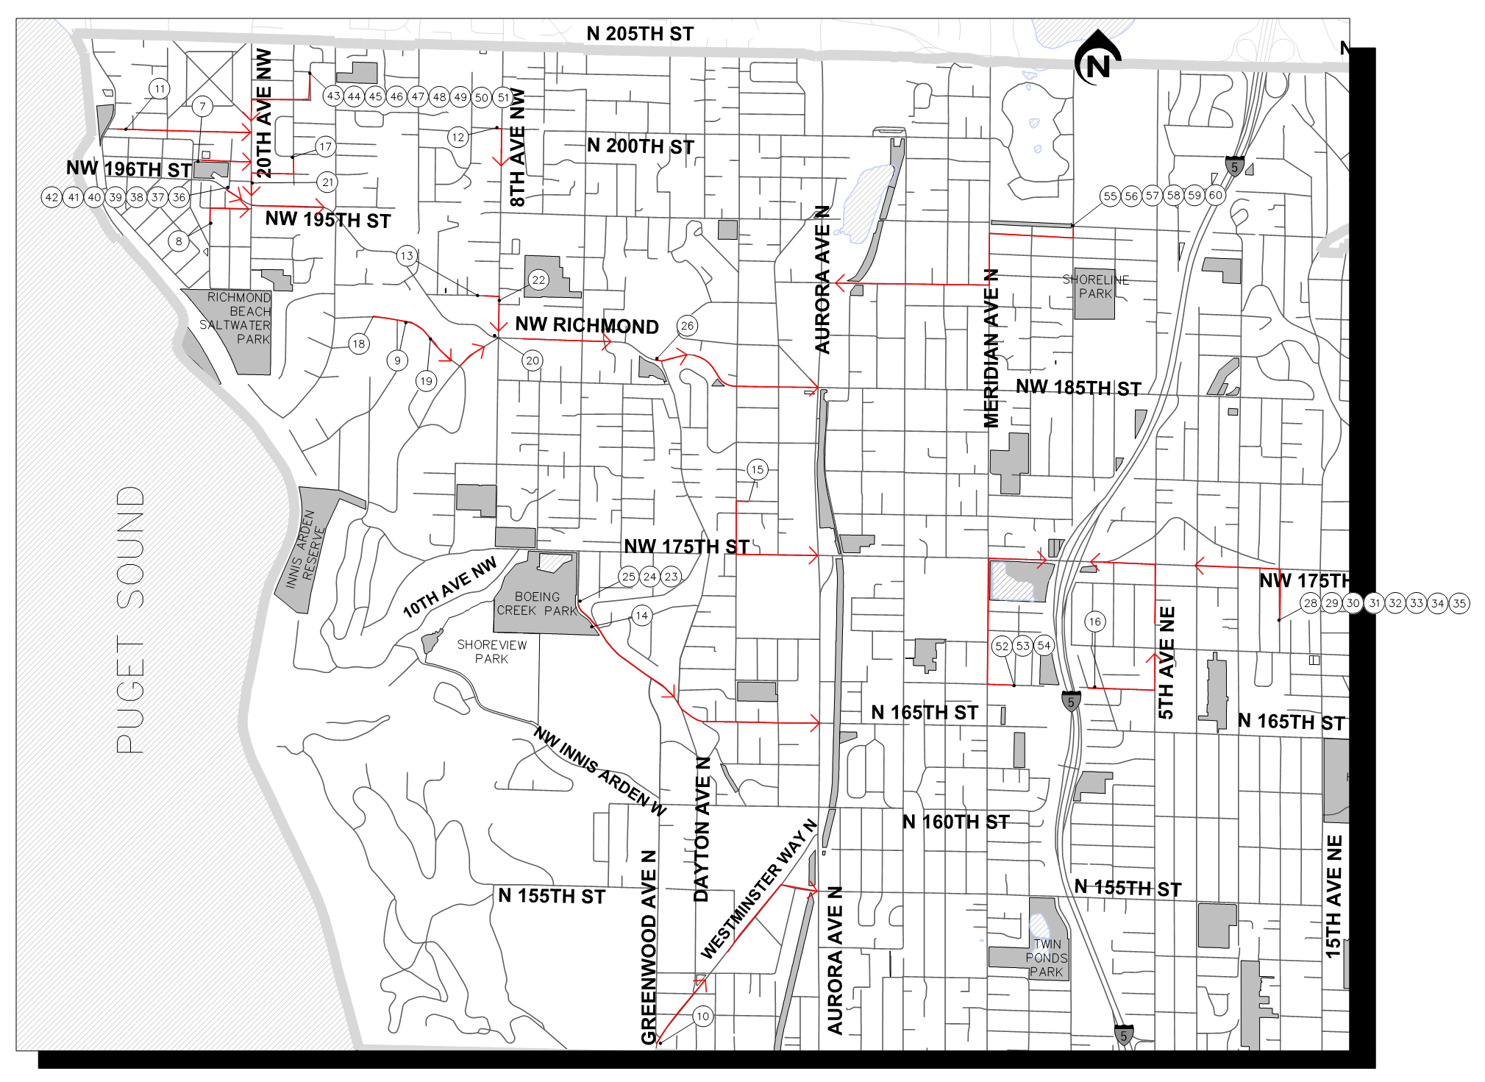
Stormwater Pipe Repair and Replacement Program
Project Limits: Citywide.
Scope: To repair damaged stormwater pipes, prioritized based on severity of damage and importance of pipe. Combination of CIPP and open-cut repairs. Multiple sites batched into one project.
Status: Design for 2022 construction (open-cut)
Construction Window: Summer 2022
Utility Coordination Needed: No relocations anticipated.
Lea Bonebrake, PM
(206) 801-2475
lbonebrake@shorelinewa.gov
Stormwater Pipe Repair and Replaement Program

Slide 11
Surface Water Small Drainage Projects
Project Limits: Citywide.
Scope: Program to fix small public drainage issues. Construction typically includes installation of catch basins, pipes, berms and other small improvements within the public right-of-way. Multiple sites batched into one project.
Status: Design for 2022 construction
Construction Window: Summer 2022
Utility Coordination Needed: No relocations anticipated.
Lea Bonebrake, PM
(206) 801-2475
lbonebrake@shorelinewa.gov
Surface Water Small Drainage Projects

Slide 12
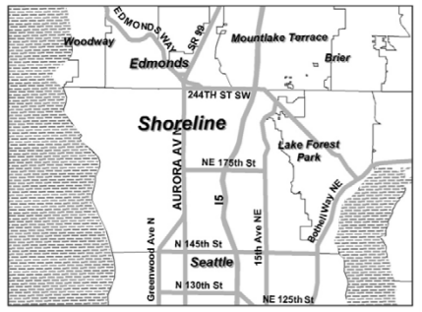
Lower Storm Creek Erosion Management Project
Project Limits: Lower end of Storm Creek (west of 17th Pl NW)
Scope: Construction to address severe down-cutting erosion of the Storm Creek channel west of 17th Pl NW
Status: Preliminary Design
Construction Window: Summer 2023
Utility Coordination Needed: Wastewater
Lea Bonebrake, PM
(206) 801-2475
lbonebrake@shorelinewa.gov
Website coming soon

Slide 13
N 148th St Non-Motorized Bridge Project
Project Limits: N 148th Street & I-5
Scope: Construct a new ped/bike bridge over I-5 at N 148th Street to provide a connection between 1st Ave NE and the new Shoreline South/148th Station.
Status: 90% Design
Construction Window: Phase 1: Summer 2022-Spring 2023 Phase 2: TBD
Utility Coordination Needed: (Phase 1) Wastewater and SCL (Phase 2) SCL and communication relocations.
Lea Bonebrake, PM
(206) 801-2475
lbonebrake@shorelinewa.gov
N 148th Non-Motorized BridgeProject

Slide 14
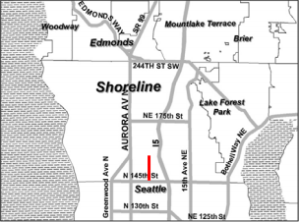
1st Ave NE Sidewalks (N 145th to N 155th)
Project Limits: 1st Avenue NE between N 145th Street and N 155th Street.
Scope: Construct sidewalk along 1st Ave NE.
Status: Contracting / Preliminary Design
Construction Window: Spring/Summer 2023
Utility Coordination Needed: Utility adjustments and relocations.
Leif Johansen, PM
(206) 801-2489
ljohansen@shorelinewa.gov
1st Avenue NE Sidewalks (145th- 155th)

Slide 15
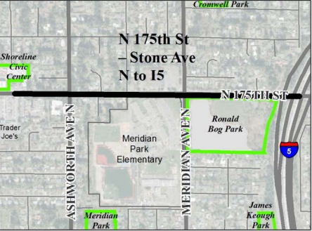
N 175th Street (Stone Avenue N to I-5)
Project Limits: N 175th Street between Stone Avenue N and I-5
Scope: Reconstruct roadway. New signal at Meridian/175th St. Provide pedestrian and bicycle facilities. Utility undergrounding. Water and sewer relocation/upgrades are expected
Status: 50% Design, Utility Coordination
Construction Window: 2025 and beyond
Utility Coordination Needed: SCL, SPU, Comcast, Ziply, PSE, RWD
Leif Johansen, PM
(206) 801-2489
ljohansen@shorelinewa.gov
N 175 Street Corridor Improvements Project

Slide 16
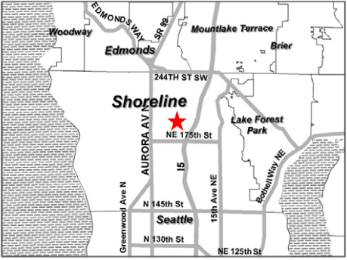
Meridian Avenue Safety Improvements
Project Limits: Meridian Avenue between N 155th Street and N 175th Street.
Scope: Rechannelize Meridian Avenue. Install RRFBs at N 163rd Street and N 17oth Street.
Status: Contracting/Preliminary Design
Construction Window: Spring/Summer 2023
Utility Coordination Needed: Power service for RRFB and utility adjustments (WA and telecom.)
Leif Johansen, PM
(206) 801-2489
ljohansen@shorelinewa.gov
Meridian Avenue Safety Improvements

Slide 17
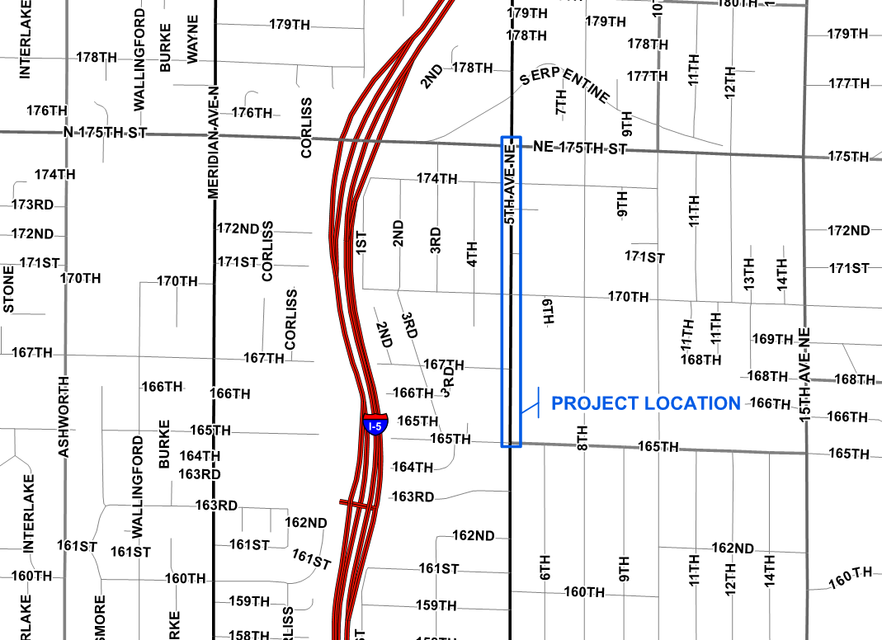
5th Ave NE (165th to 175th) Sidewalk Rehabilitation
Project Limits: 5th Ave NE between NE 165th St and NE 175th St.
Scope: Remove barriers to pedestrian mobility. Sidewalk and ramp spot repairs.
Status: Preliminary design
Construction Window: Spring/Summer 2023
Utility Coordination Needed: Utility adjustments
Leif Johansen, PM
(206) 801-2489
ljohansen@shorelinewa.gov
Website coming soon

Slide 18
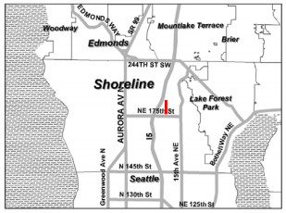
New Sidewalks, 5th Ave NE: 175th to 182nd
Project Limits: 5th Avenue NE from N 175th Street to near 182nd Court.
Scope: Construct new concrete sidewalks on the both sides of 5th Avenue NE.
Status: Construction
Construction Window: April - September 2022
Utility Coordination Needed: SCL power pole relocation, North City hydrant/valve/meter relocations, PSE relocation
Laura Reiter, PM
(206) 801-2475
lreiter@shorelinewa.gov
New Sidewalks: 5th Avenue NE (175th St to 182nd Ct)

Slide 19
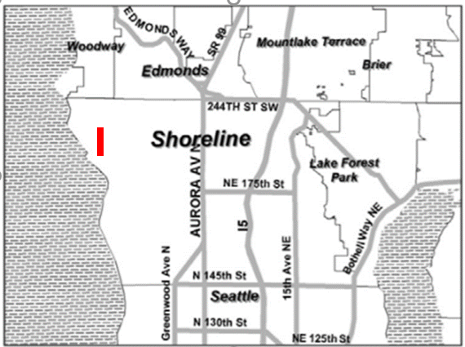
New Sidewalks, 20th Ave NW: 190th to 195th
Project Limits: 20th Avenue NE from NW 190th – NW 195th Street
Scope: Construct new concrete sidewalks on the west side of 20th Avenue NW.
Status: Design
Construction Window: September – November 2022
Utility Coordination Needed: SCL power pole relocation, SPU meter relocations, PSE gas services
Laura Reiter, PM
(206) 801-2475
lreiter@shorelinewa.gov
New Sidewalks: 20th Ave NW (190th St to 195th St)

Slide 20
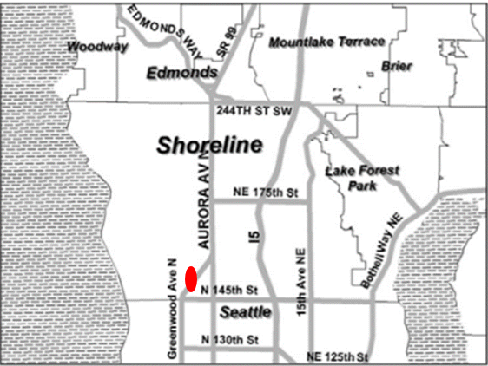
New Sidewalks, Westminster Way (145th – 153rd)
Project Limits: Westminster Way from 145th to 153rd St.
Scope: Construct new concrete sidewalks on the one side of Westminster Way.
Status: Pre-Design
Construction Window: April - September 2023
Utility Coordination Needed: SCL power pole relocation, SPU hydrant/valve/meter relocations, PSE relocation
Laura Reiter, PM
(206) 801-2475
lreiter@shorelinewa.gov
Website coming soon

Slide 21
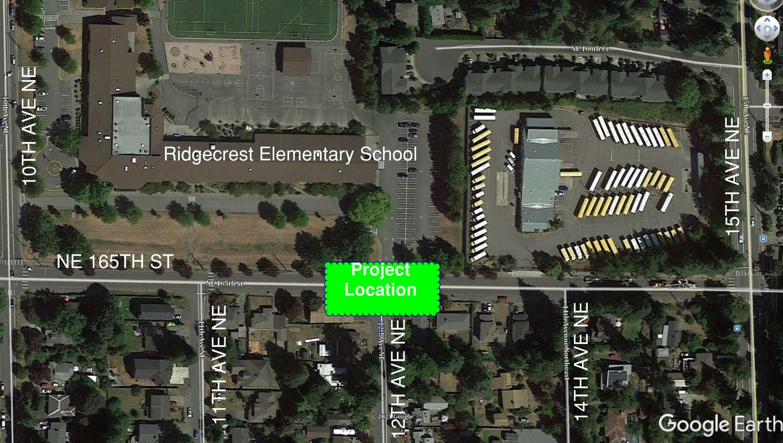
Ridgecrest Safe Routes to School
Project Limits: NE 165th Street between 10th Avenue NE and 15th Avenue NE.
Scope: Installing two new school speed zone flashers and speed feedback signs, curb extensions, and crosswalk signage.
Status: Design
Construction Window: June / August 2022
Utility Coordination Needed: SCL service
Laura Reiter, PM
(206) 801-2457
lreiter@shorelinewa.gov
Ridgecrest Safe Routes to School

Slide 22
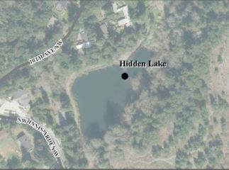
Hidden Lake Dam Removal
Project Limits: Hidden Lake within Shoreview Park and the adjacent NW Innis Arden Way.
Scope: Removal of Hidden Lake Dam, restoration of Boeing Creek through the existing lake, and replacement of the culverts under NW Innis Arden Wy.
Status: Design
Construction Window: Phase 1: May/September 2022 Phase 2: May/September 2024
Utility Coordination Needed: None for Phase 1; SPU/Comcast for Phase 2
Laura Reiter, PM
(206) 801-2457
lreiter@shorelinewa.gov
Hidden Lake Dam Removal

Slide 23
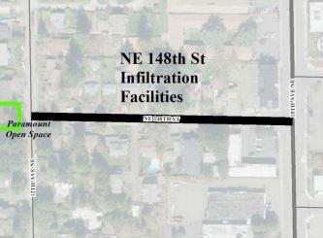
NE 148th Street Infiltration Facilities
Project Limits: NE 148th Street from 12th Ave NE to 15th Avenue NE.
Scope: Construction of underground infiltration facilities.
Status: Construction
Construction Window: April / May 2022
Utility Coordination Needed: North City Water District service/meter relocation
Laura Reiter, PM
(206) 801-2457
lreiter@shorelinewa.gov
NE 148th Infiltration Facilities

Slide 24
City Maintenance Facility (Ballinger)
Project Limits: Brightwater Maintenance Facility Site 20031 Ballinger Way NE.
Scope: New city maintenance facility for vehicle fueling and washing, snow and ice removal, decant facility, and site improvements.
Status: Design
Construction Window: April 2022 – January 2023
Utility Coordination Needed: Utility connections approved thru site development permit.
Zachary Evans, PM
(206) 801-2428
zevans@shoreline.wa.gov
City Maintenance Facility (Ballinger)

Slide 25
15th Ave NE Sidewalk Rehabilitation
Project Limits: 15th Ave NE sidewalks from NE 155th St to NE 175th St
Scope: Repair damaged sidewalk panels, install new ADA ramps and repair other minor barriers to ADA access as funding allows.
Status: Design
Construction Window: July 2022 – December 2022
Utility Coordination Needed: Potential relocation of water meters to amenity zone.
Zachary Evans, PM
(206) 801-2428
zevans@shoreline.wa.gov
15th Ave NE Sidewalk Rehabilitation

Slide 26
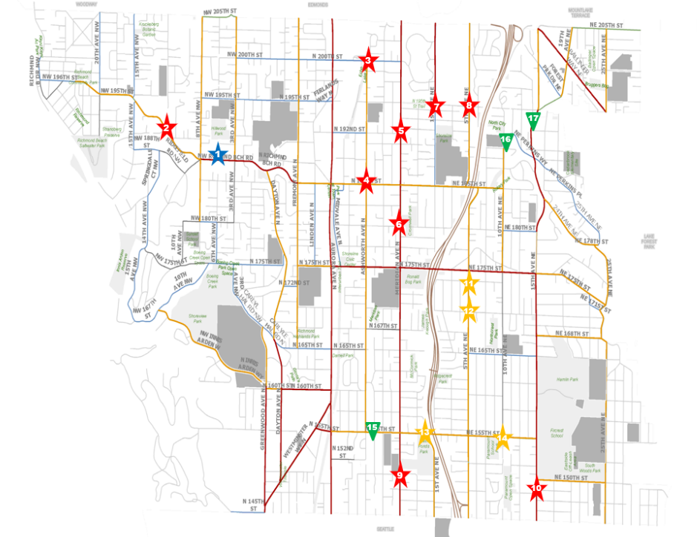
Richmond Beach Midblock Crossing and Citywide Rectangular Rapid Flashing Beacons (RRFB) and Radar Speed Signs (RSS)
Project Limits: Midblock crossing on NW Richmond Beach Road between 8th Ave NW and 3rd Ave NW. Multiple locations for RRFB and RSS. See vicinity map.
Scope: New midblock crossing with ADA ramps, refuge island, RRFBs and upgraded lighting. RRFB installation at 9-13 pedestrian crosswalks plus minor striping improvements. 3 RSSs locations.
Status: Design
Construction Window: Fall 2022- Winter 2023
Utility Coordination Needed: Potential impact to water meters at midblock crossing. Coordination with SCL on potential hardwire RRFBs.
Zachary Evans, PM
(206) 801-2428
zevans@shoreline.wa.gov
Richmond Beach Road Midblock Crossing

Slide 27
Pump Station 26 Improvements Project
Project Limits: Pump Station 26 (18351 10th Ave NE)
Scope: Full replacement of existing pump station and detention pond at PS-26 and frontage improvements. Same construction contract as Miscellaneous Pump Stations project.
Status: Design
Construction Window: April 2022 – December 2022
Utility Coordination Needed: Power and water approved thru site development permit.
Zachary Evans, PM
(206) 801-2428
zevans@shoreline.wa.gov
Pump Station 26 Improvements Project

Slide 28
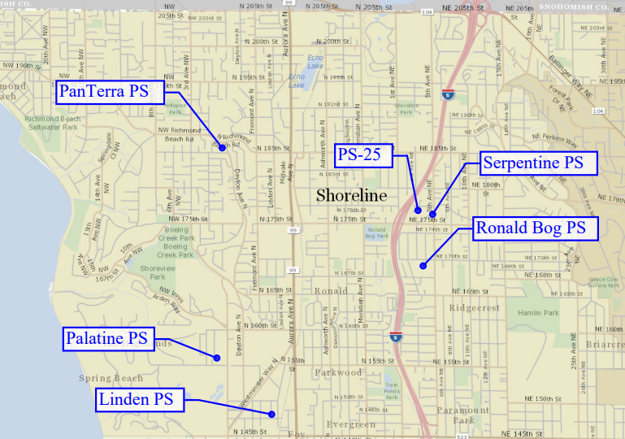
Pump Station Miscellaneous Improvements
Project Limits: Minor improvements at 6 existing surface water pump stations. See vicinity map.
Scope: Minor pump station improvements such as adding SCADA, signage, safety grates, post mounts, etc. Same construction contract as PS-26.
Status: Preliminary Design
Construction Window: April 2022 – December 2022
Utility Coordination Needed: Minor electrical service upgrades, general coordination for minor trench work in the ROW.
Zachary Evans, PM
(206) 801-2428
zevans@shoreline.wa.gov
Pump Station – Miscellaneous Sites

Slide 29
Annual Road Surface Maintenance
Project Limits: 2022 – 155th Overlay Midvale to I-5
Scope: 155th overlay – grind and overlay, ADA ramps to standard.
Status: 2022 155th overlay – in Design
Construction Window: 155th overlay – Summer 2022 – Spring 2023
Utility Coordination Needed: 155th overlay – complete utility work in advance of overlay
Kristin Terpstra, PM
(206) 391-3364
kterpstra@shorelinewa.gov
Annual Road Surface Maintenance Program

Slide 30
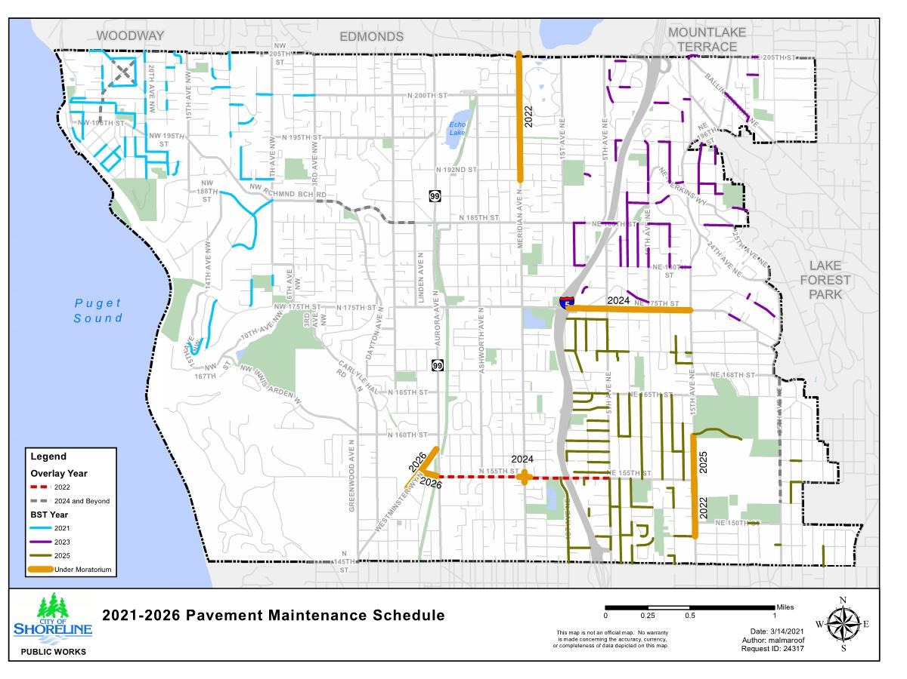
Pavement Maintenance/Moratorium Map http://www.shorelinewa.gov/government/projects-initiatives/annual-road-surface-maintenance-program
Insert Map

Slide 31
SR-523 (N/NE 145th Street), Aurora Avenue N to I-5
Project Limits: N 145th Street (Linden Avenue to I-5)
Scope: Widen 145th Street to accommodate design elements that will improve traffic operations, safety and mobility throughout the corridor.
Status: Design & ROW (Phase 1)
Construction Window: Phase 1 (I-5 to Corliss): 2023/2024 Phase 2 (Corliss to Wallingford): 2025/2026 Phase 3 (Wallingford to Linden): TBD
Utility Coordination Needed: SCL undergrounding approach & subarea service needs, SPU water & stormwater, JUT for communication
Cory Nau, PM
(206) 801-2325 cnau@shorelinewa.gov
145th Street Corridor Project

Slide 32
SR 523(145th) and I-5 Interchange Project
Project Limits: SR 523 (NE 145th) 1st Avenue NE to 6th Avenue NE
Scope: Replace signalized intersections at I-5 Southbound and 5th Avenue NE with Roundabouts.
Status: Design (30%)
Construction Window: Fall 2022 through December 2023
Utility Coordination Needed: SCL power line relocation SPU water main relocation
Robert McGaughy, PM
rmcgaughey@shorelinewa.gov 145th & I5 Interchange Project

Slide 33
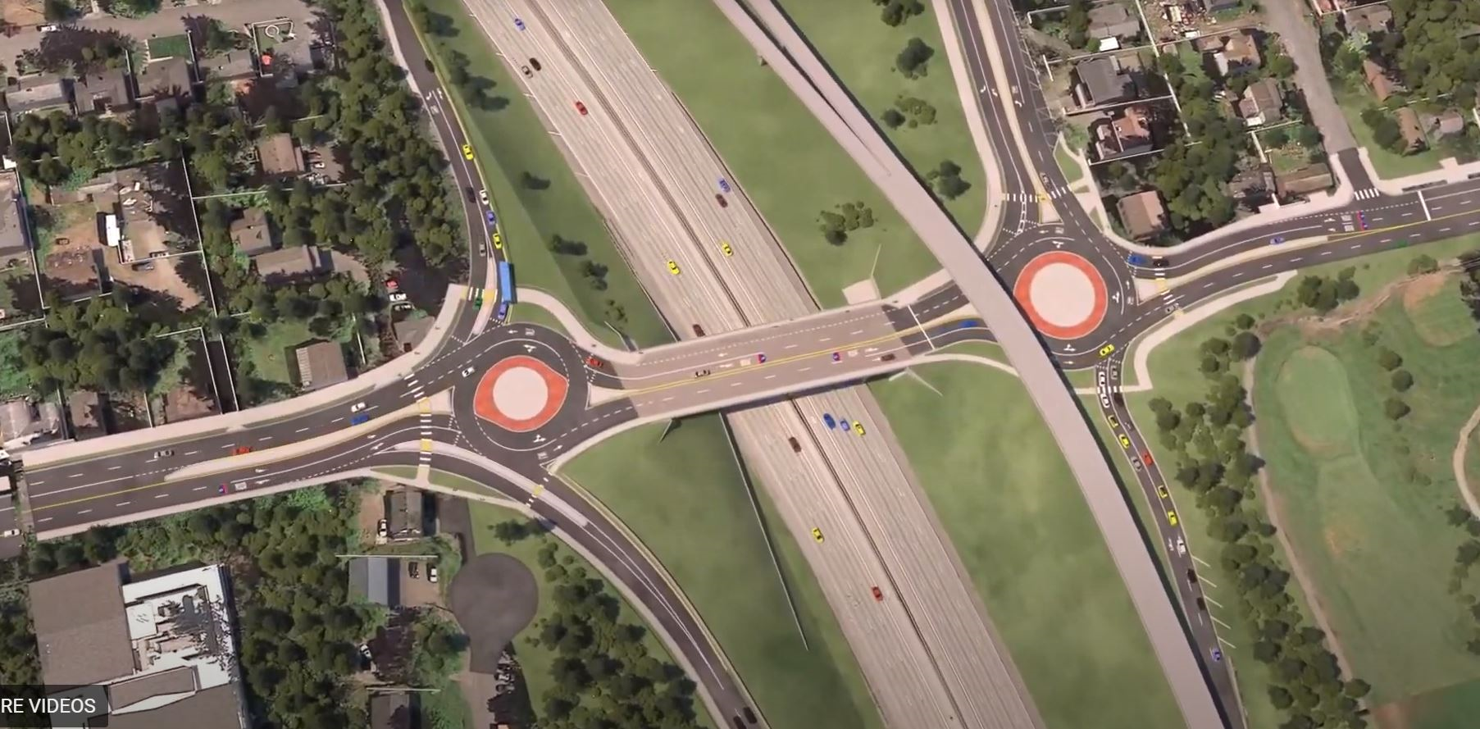
SR 523(145th) and I-5 Interchange Project

Slide 34
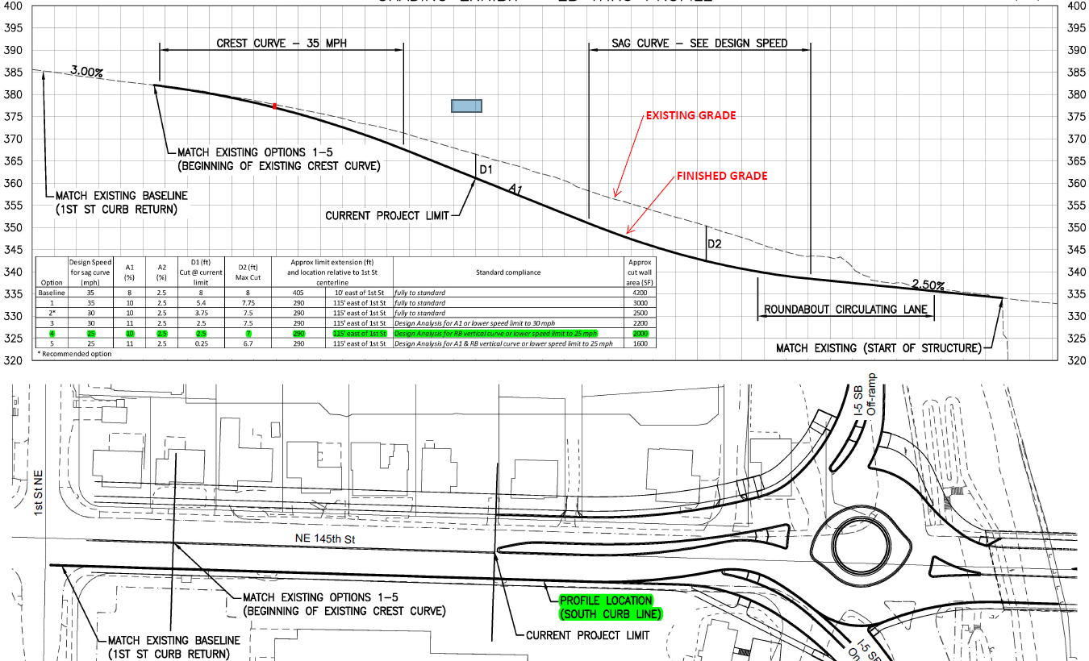
SR 523(145th) and I-5 Interchange Project
Placeholder for grading profile

Slide 35
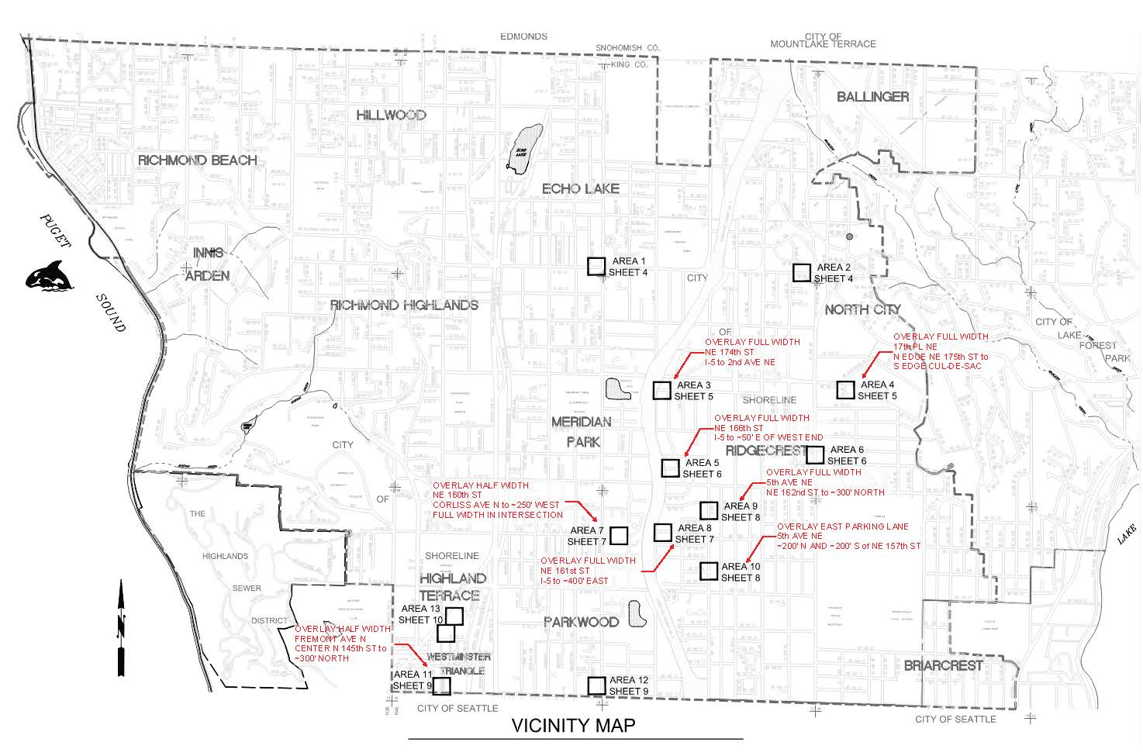
Ridgecrest 5 CIP Sanitary Sewer Replacement
Project Limits: Various locations, see vicinity map.
Scope: Construction of approx. 3,600 linear ft of 8-inch HDPE sanitary sewer main via pipe bursting; replacement of approx. 61 associated side sewers via pipe bursting; installation of approximately 100 associated clean outs; rehabilitation of approximately 20 associated manholes; surface restoration; ADA ramp replacement; asphalt grind and overlay; and pavement marking replacement.
Status: Post 90% COSH Plan and Spec review, 100% Bid Set in progress.
Construction Window: July 2022 – May 2023
Utility Coordination Needed: Overlays noted in red above, if other utility work is planned in overlay area in near future, may be beneficial to combine work
Tucker Collins, PM
WWU Consultant Engineer
David Evans and Assoc., Inc.
(425) 586-9748
Tucker.Collins@deainc.com

