Slide 1
Some things we’ve heard…
“…proposed changes are going to cause serious congestion problems!”
“… calls for bike lanes, and completely ignores the safety of pedestrians”
“What an awful plan.”
“It is going to be misery down Richmond Beach Road”
“Bikes never use this road.”
“the City of Shoreline is not being straight forward in this project.”
“…why waste so much money on a road that has been working just fine for the last 30 yrs I have lived here.”
“…rechannelization only between 3rd and 8th where it is needed.”
“As one who actually LIVES on Richmond Beach Road, I am well aware of the current traffic conditions and every day I am reminded that the proposed solution would make this community much safer”

Slide 2
Richmond Beach Road Rechannelization – Welcome!
Structure of Today’s Meeting:
6:05-6:25 Staff Presentation
6:25-7:05 Open House & Feedback Opportunity
(Fill out question cards for group Q&A by 6:45)
7:05-7:30 Reconvene for group Q&A
7:30-7:45 Wrap up & exit survey
Listen, value others, and treat everyone with fairness and dignity.
Notes:
I will address some of the safety and mobility benefits first, describing the premise of the project. Slides toward the end of the presentation will address some common concerns we’ve heard so far. In addition, there is a lot of information set up around the room for you all to view after this presentation. Many of the diagrams are too detailed to put into this presentation, and staff will be available to answer questions.
We’re going to start by watching a short video to provide some context on the broader concept of a 4 lane to 3 lane conversion, sometimes called a road diet. Then I’ll talk more about the specifics along our corridor and how this concept applies to the unique characteristics of Richmond Beach Rd.

Slide 3
Background
This project will restripe Richmond Beach Road from 4 lanes to 3 between west of Dayton Ave NW to 24th Ave NW.
Needed to improve driver, pedestrian, and bicyclist safety.
Many intersections will retain additional turn lanes, limiting delay.
We need your input which will shape many features of the design moving forward.

Slide 4
How Did We Get Here?
2011 Transportation Master Plan (TMP) – Slated bike lanes for the corridor.
Annual Traffic Report – Consistently identifies the need for safety improvements based on collision patterns.
Capital Improvement Plan (CIP) – This low cost project concept was added to the 2016-2021 CIP, and adopted by Council as a cost effective way to address both safety & mobility needs.
2017
2018
Budget: $215,000
Notes:
This concept was developed in consideration of where we are today, with collisions, and increasing interest in nonmotorized safety. We are not bound by the past or the looming future.
Despite improvements which decreased collision, intersection of 3rd still highest rate of collision in the City.

Slide 5
Collision History
COLLISIONS (2010-2016)
154 Total
20 Injury
10 Pedestrian
3 Bicyclist
Intersection phase changes at 3rd have helped, but there are still a lot of collisions occurring there.
Notes:
High volume of non-injury collisions; many as a result of the friction caused by turning movements which would benefit from having a center turn lane. The intersections and street segment between 3rd Ave NW and 8th Ave NW experienced 30 collisions over just a 3 year period.
There is significant speeding in the corridor which increases the risk of collision frequency and severity. Traffic data shows that 68% of drivers traveling west of 8th Ave NW are exceeding 35 mph.

Slide 6
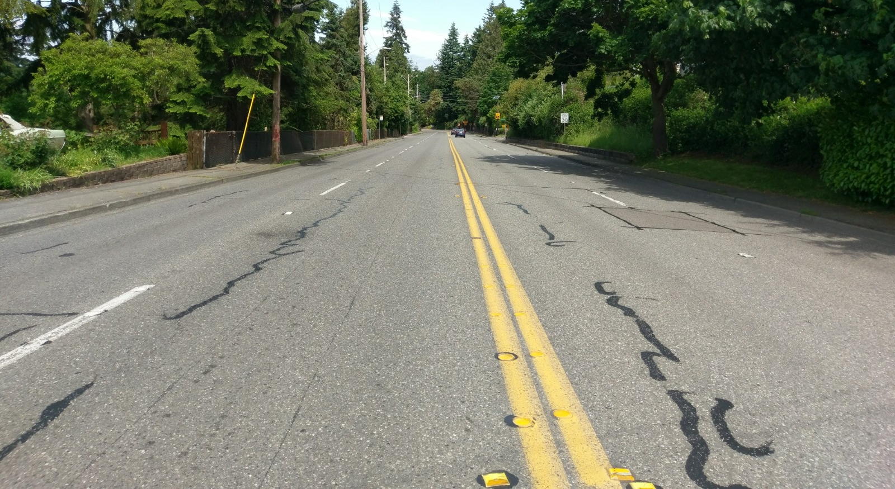
Speeding
Wide roads with underutilized lanes the majority of the day encourage speeding
Vehicle speed is a critical factor in injury collisions, especially for the most vulnerable users (pedestrian & bicyclists)
Over 50% of drivers are traveling over 35 mph
Notes:
High volume of non-injury collisions; many as a result of the friction caused by turning movements which would benefit from having a center turn lane. The intersections and street segment between 3rd Ave NW and 8th Ave NW experienced 30 collisions over just a 3 year period.
There is significant speeding in the corridor which increases the risk of collision frequency and severity. Traffic data shows that 68% of drivers traveling west of 8th Ave NW are exceeding 35 mph.

Slide 7
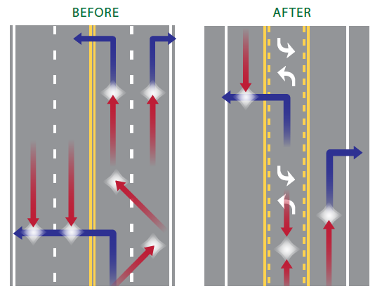
Safety - Vehicles
Reduces speeding and speed differential, a main cause of collisions, and significant factor in injuries
Reduces conflict points and provides dedicated left turn space as shown below
Reduces Speeding
Notes:
Proven collision countermeasure. Area in the room with other regional examples and case studies.
Many roadways that function quite well with 3 lanes, and in a more safe manner. Video of turning at driveway?
Prudent driver sets speed.

Slide 8
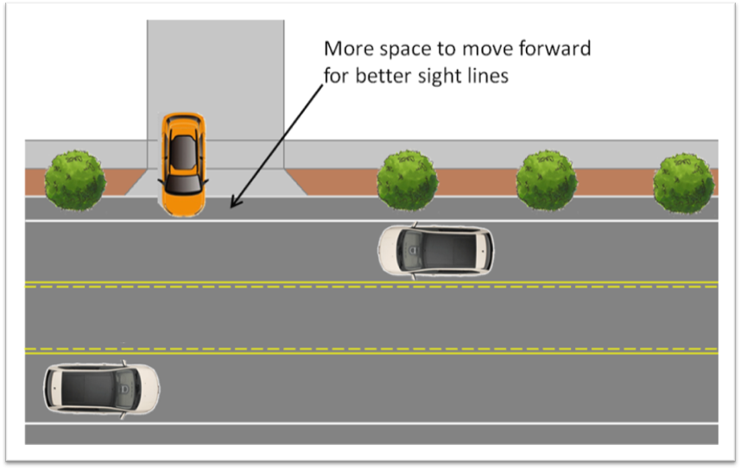
Safety - Vehicles
Improves sight distance when turning from a side street/driveway or from the mainline
Aggregated case studies throughout the country show 19-47% crash reduction
19-47% CRASH REDUCTION
Notes:
Proven collision countermeasure. Area in the room with other regional examples and case studies.
Many roadways that function quite well with 3 lanes, and in a more safe manner. Video of turning at driveway?
Prudent driver sets speed.

Slide 9
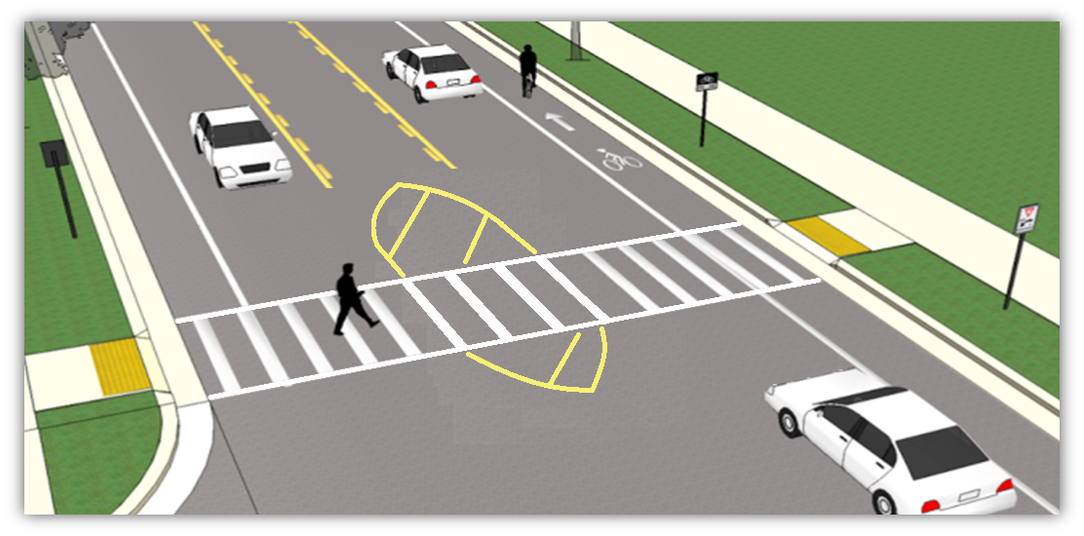
Safety - Pedestrians
Over 90% of pedestrian collisions occur when people cross the road; restripe creates space for “pedestrian refuge” for people crossing.
Fewer lanes to cross = safer, reduces pedestrian exposure.
Provides buffer - adds 6 more feet between pedestrians on the sidewalk and traffic.
Notes:
Pedestrian crossing video here

Slide 10
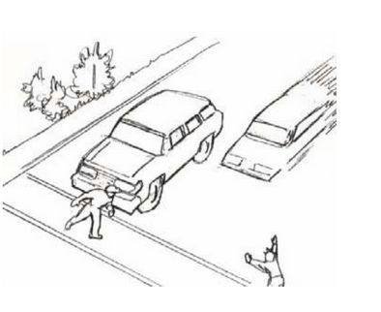
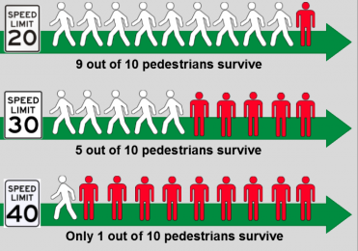
Safety - Pedestrians
Eliminates pedestrian multi-lane threat scenario where one vehicle stops, but adjacent driver fails to see the pedestrian crossing in front of the stopped car.
Reduces speeding, a main indicator in pedestrian crash survival.
Notes:
Pedestrian crossing video here

Slide 11
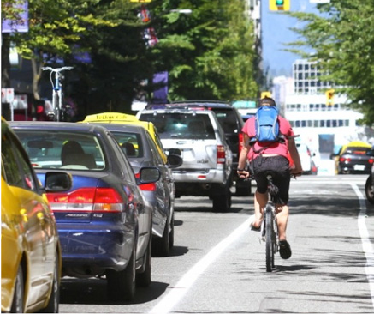
Safety - Bicyclists
Bike ridership is up 7.8% since 2011 region-wide
Traffic data suggest bicyclists use this corridor and others want to
3 bicyclists have been injured on this corridor in the last 3 years.
Bike lane markings provide the expectation for drivers to encounter bicyclists, improving their awareness and attentiveness to non-motorized users while driving.
Reducing speeds and improving sight lines improves bicyclist safety.
Notes:
Picture of bicyclist on the corridor – picture from Google (alisa?)

Slide 12
Mobility – Travel Delays
See board at traffic analysis station for detailed information about anticipated travel delays
Traffic models adjusted based on actual travel times
Notes:
Preliminary Intersection diagrams are provided in this area – some have more than one option and we want to hear your feedback. The corridor travel time is different from the delay you might experience at intersection. Specific approach delays and queue lengths are provided at the intersection diagrams. 20th video?

Slide 13
Maximum Acceptable Delay Standard (Concurrency)
WA State Growth Management Act
Local jurisdictions must adopt and enforce roadway standards for maximum acceptable delay, also known as Level of Service (LOS).
Shoreline’s Adopted Level of Service Standard for Richmond Beach Road
1. LOS D at signalized intersections
2. A volume to capacity (V/C) ratio of 0.90*
*The V/C ratio on one leg of an intersection may exceed 0.90 when the intersection operates at LOS D or better.
What does this mean?
The City’s projects must meet this standard, unless otherwise approved by Council.
All development must also meet this standard. More lanes for vehicles means development can add more cars without mitigation.
Notes:
Comparison to Seattle standards – Shoreline accepts less delay than Seattle
(Average 35-55 second delay per vehicle)
LOS A is not what you should strive for – this means roadway is underutilized/overbuilt.

Slide 14
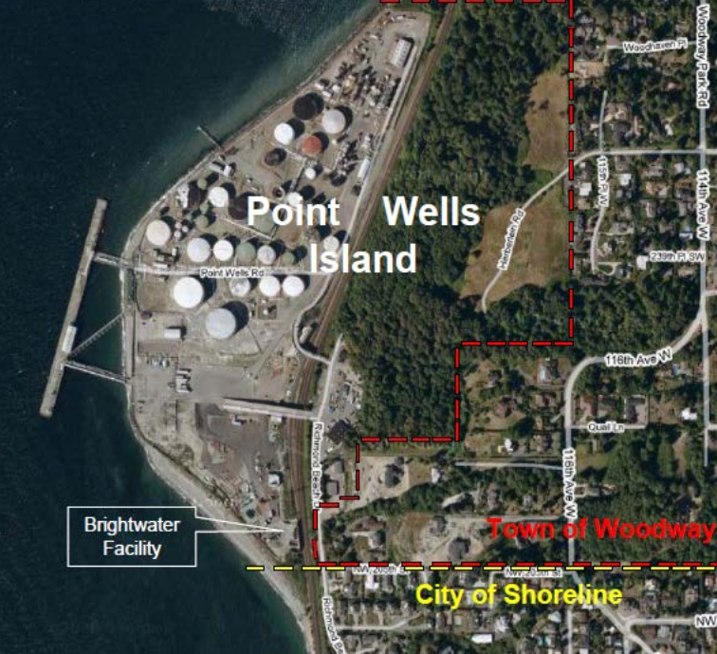
Concern - What About Point Wells?
It would not be prudent for the City to postpone necessary safety and mobility improvements because of a yet to be approved development.
Especially when the potential development’s traffic impacts are still undetermined and will not occur for at least a decade or more.
Based on traffic analysis and the City’s current level of service standards:
Fewer additional vehicular trips could be added by development without providing mitigation or modifications to the development in order to meet the City’s current level of service standard. This is true for any proposed development.
Notes:
Many of you may be aware of the proposed devlopment of the PT wells site, at the end of Richmond Beach Dr….

Slide 15
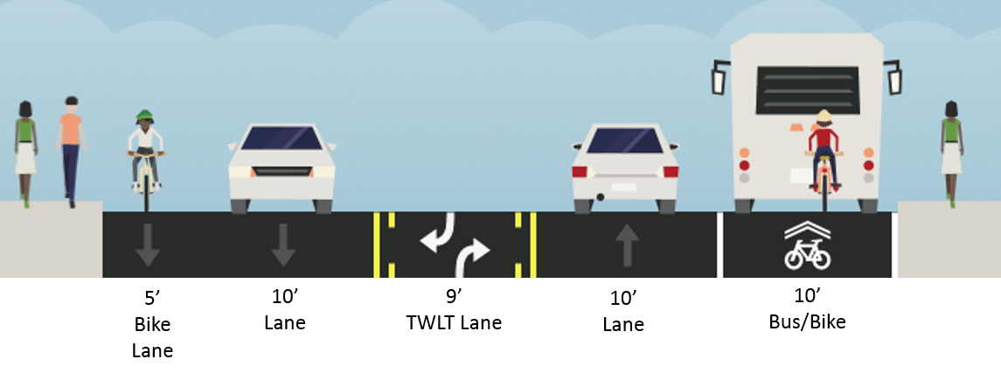
Concern - Waiting behind stopped buses
Asymmetrical design for locations with bus stops, providing wide bike lane/bus stop space. There are a maximum of 4 buses per hour at any time of day on this corridor. It is legal to go around stopped vehicles or blockages (except school buses with paddles out).
Wider bike/bus lane
At intersections
We want to hear what you think about the design choices and trade offs for this issue – see boards around the room.
Notes:
Will work with King County Metro to identify potential bus stop removals and/or relocations. It is not illegal to go around a stopped bus.

Slide 16
Concern - Following Slow Moving Vehicles
It is illegal for slow moving vehicles to hold up more than 5 vehicles; The wider bike lane proposed for bus stops could serve as truck pullouts.
The City has some regulatory authority on truck operations and can develop a strategy for operations if needed.
Contingency plan concept if slow moving vehicle delay proves to be a bigger impact than anticipated as shown below.
downhill
uphill
Car Lane Shared w/ Bikes
Center Turn
Lane
Car
Lane
Truck/Bus/Bike Lane Only
34 mph speed following a Metro bus uphill
Notes:
This 4 lane to 3 lane conversion has been implemented on many streets with hills as well. The nearby case study we brought along, 75th AVE NE in Seattle, provides a comprehensive before and after study with a 10 block segment occurring on a hill.

Slide 17
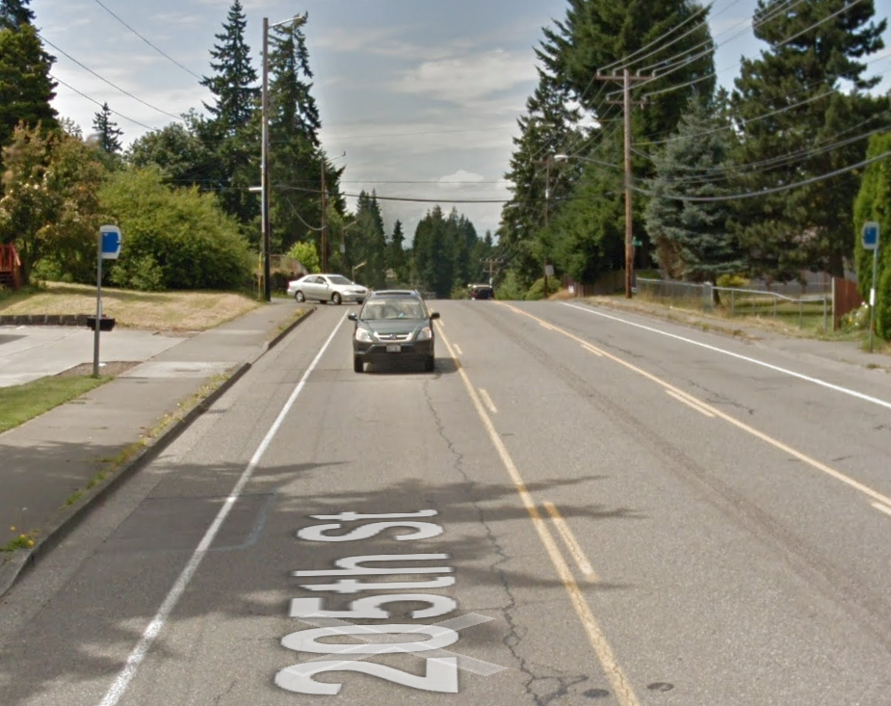
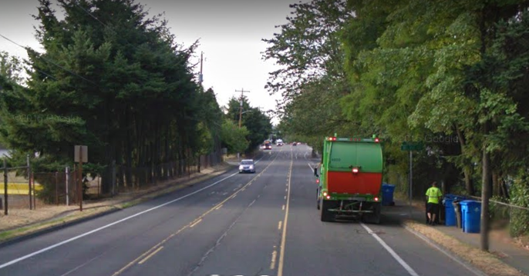
Concern - Garbage Pickup and Delivery Blockages
It is legal to go around stopped, blocking vehicles.
Stopped vehicles will primarily be contained in the bike lane, leaving plenty of room for drivers to safely go around, especially considering the center turn lane will be mostly unoccupied on segments of the corridor where this would occur.
Notes:
Talk about 2 lane similarities – Greenwood Ave N for example, similar volumes to west of 8th.

Slide 18
Concern - Cut Through Traffic
We don’t expect to see much traffic diversion since the project doesn’t significantly increase delay.
We still want to hear what you think some primary cut through routes will be.
Once we have this information we will collect data and monitor the before vs. after.
If significant cut through is present, we can implement traffic calming as part of our Neighborhood Traffic Safety Program.
We want to hear where you think cut through traffic will occur – see roll plot station.

Slide 19
Seeking Feedback
Intersection Design Options – more than one for some, which do you prefer?
Lane width and alignment choices and trade offs for bus stops.
What streets do you think are most likely to see cut through traffic?
Please tell us about any specific problem areas you experience using post-its on the roll plot.
Notes:
(Point to areas in the room where stations are related to seeking feedback)

Slide 20
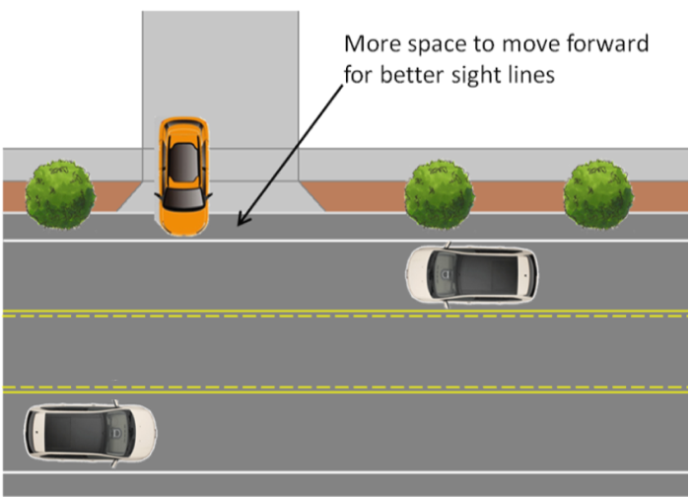
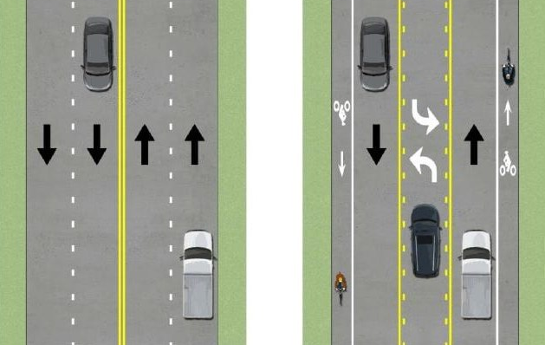

Slide 21
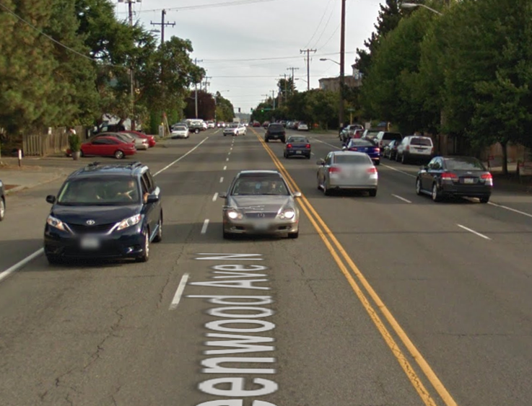
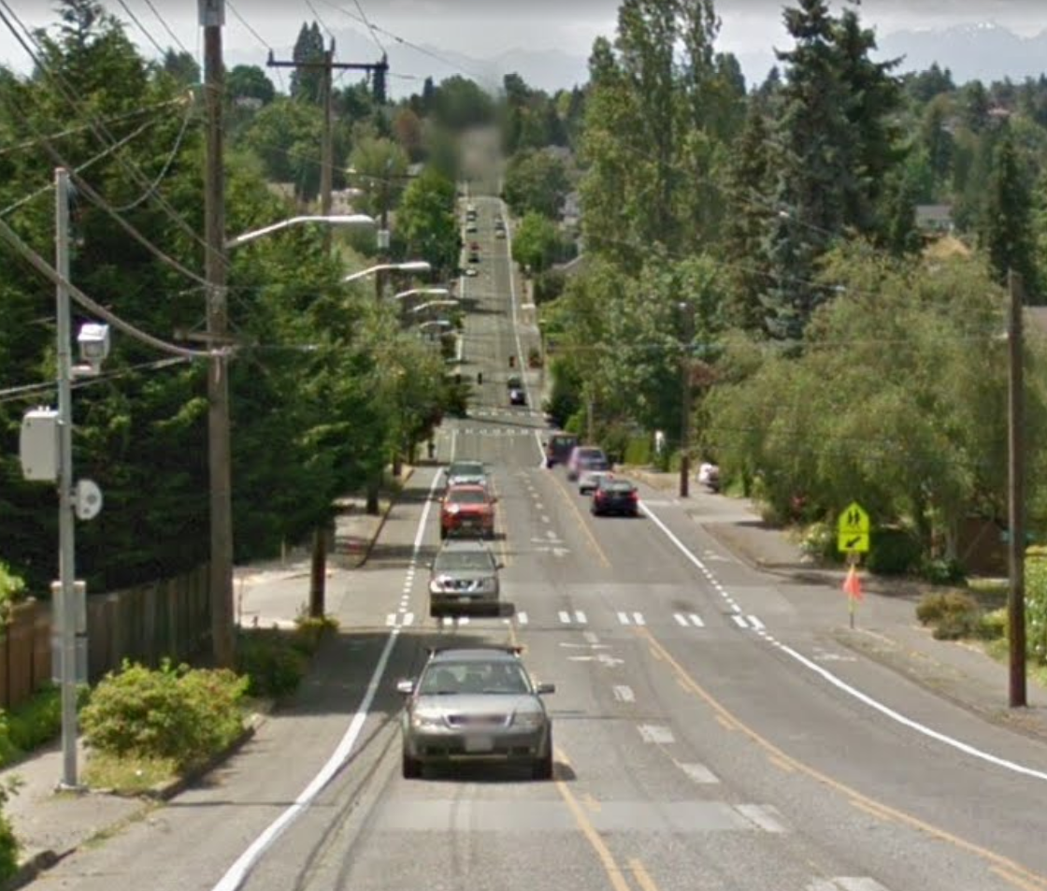
Concern – Emergency Response
Notes:
(Point to areas in the room where stations are related to seeking feedback)

